Slide 1

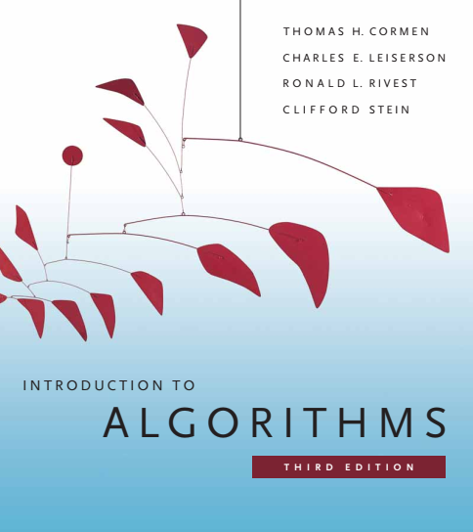
Design and Analysis of Algorithms
Dr. Sajid Iqbal
sajidiqbal.pk@gmail.com
Reference Book
Introduction to Algorithms 3rd Edition By Thomas H. Cormen et. al.
https://mitpress.mit.edu/books/introduction-algorithms-third-edition
COMEDXD

Slide 2
Solving Recursion
Master theorem method

Slide 3

Master Theorem
It provides a short cut to solve recursions of the form
$T(n)=aT(n/b)+f(n)$ $∴a≥1 and b>1 and f\left(n\right) is a positive function$
This method applies to Divide and Conquer problems
There are three cases of master method and you will need to memorize them.
After memorizing, you will be able to solve many recurrences without doing complex mathematics
The function $f(n)$ covers the cost of dividing the problem and combining the results of the subproblems

Slide 4

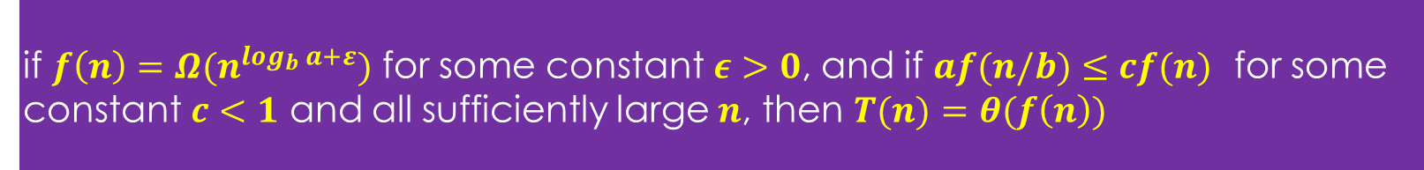
Master Theorem
Let T(n) is the time complexity of an algorithm given as
$T(n)=aT(n/b)+f(n)$
Let $a≥1$ and $b>1$ be constants and $f(n)$ be a function
$\left\lfloor \frac{n}{b}\right\rfloor$and $\left\lceil \frac{n}{b}\right\rceil$ can be represented by $n/b$
if $f\left(n\right)=O(n^{\log_{b}{a−ε}})$ for some constant $ε>0$ then $T\left(n\right)=θ\left(n^{\log_{b}{a}}\right)$
if $f\left(n\right)=O(n^{\log_{b}{a}})$ then $T\left(n\right)=θ\left(n^{\log_{b}{a}}\log_{2}{n}\right)$
if $f\left(n\right)=Ω(n^{\log_{b}{a+ε}})$ for some constant $ε>0$, and if $af(n/b)≤cf(n)$ for some constant $c<1$ and all sufficiently large $n$, then $T(n)=θ(f\left(n\right))$

Slide 5
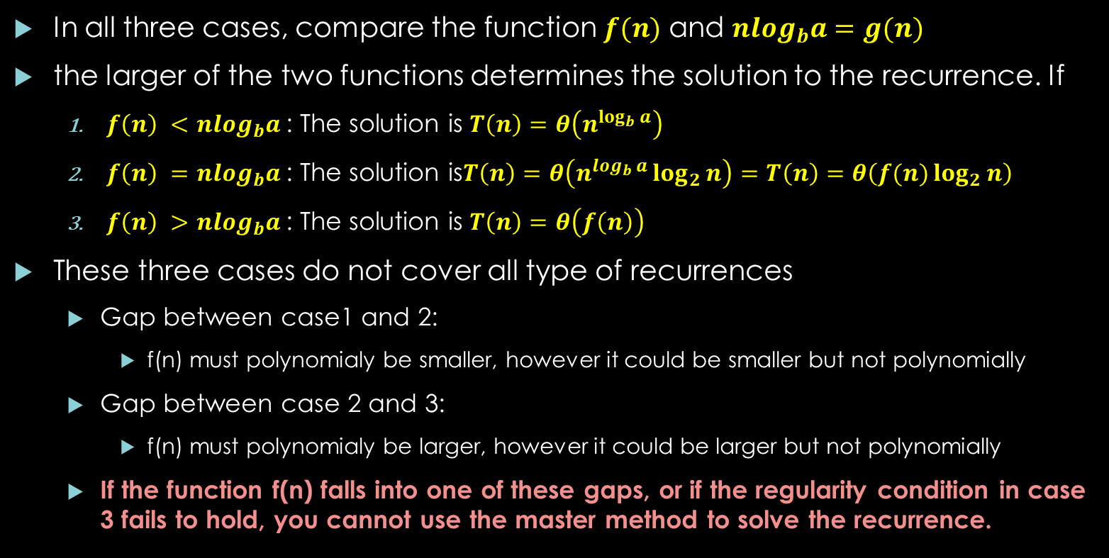
Master Theorem - Explained
In all three cases, compare the function $f(n)$ and $nlog_{b}a=g(n)$
the larger of the two functions determines the solution to the recurrence. If
$f\left(n\right) <nlog_{b}a$: The solution is $T\left(n\right)=θ\left(n^{\log_{b}{a}}\right)$
$f\left(n\right) =nlog_{b}a$: The solution is$T\left(n\right)=θ\left(n^{\log_{b}{a}}\log_{2}{n}\right)=T\left(n\right)=θ\left(f(n)\log_{2}{n}\right)$
$f\left(n\right) >nlog_{b}a$: The solution is $T\left(n\right)=θ\left(f\left(n\right)\right)$
These three cases do not cover all type of recurrences
Gap between case1 and 2:
f(n) must polynomialy be smaller, however it could be smaller but not polynomially
Gap between case 2 and 3:
f(n) must polynomialy be larger, however it could be larger but not polynomially
If the function f(n) falls into one of these gaps, or if the regularity condition in case 3 fails to hold, you cannot use the master method to solve the recurrence.

Slide 6
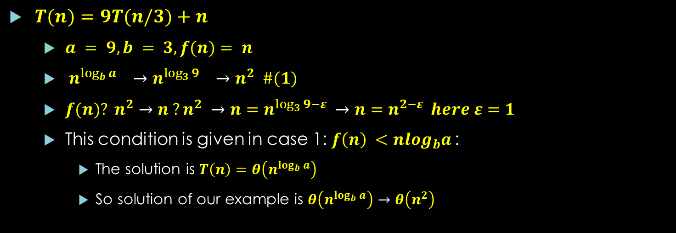
Using Master Theorem – Example 1
if $f\left(n\right)=O(n^{\log_{b}{a−ε}})$ for some constant $ε>0$ then $T\left(n\right)=θ\left(n^{\log_{b}{a}}\right)$
$T(n)=9T(n/3)+n$
$a = 9, b = 3, f(n)= n$
$n^{\log_{b}{a}} →n^{\log_{3}{9}} →n^{2} \#(1)$
$f(n)? n^{2}→n ?n^{2} →n=n^{\log_{3}{9}−ε} →n=n^{2−ε} here ε=1$
This condition is given in case 1: $f\left(n\right) <nlog_{b}a$:
The solution is $T\left(n\right)=θ\left(n^{\log_{b}{a}}\right)$
So solution of our example is $θ\left(n^{\log_{b}{a}}\right)→θ\left(n^{2}\right)$

Slide 7
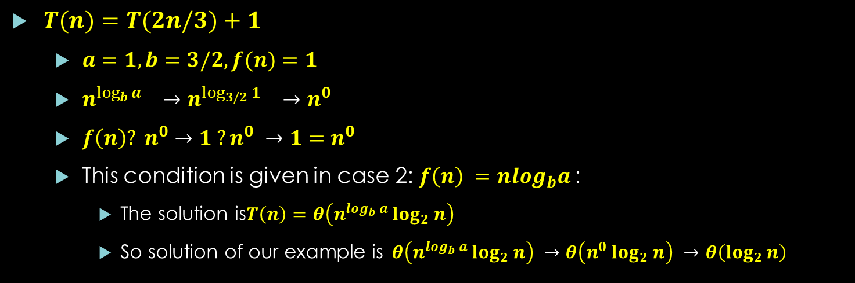
Example 2
if $f\left(n\right)=O(n^{\log_{b}{a}})$ then $T\left(n\right)=θ\left(n^{\log_{b}{a}}\log_{2}{n}\right)$
$T(n)=T(2n/3)+1$
$a=1, b=3/2, f(n)=1$
$n^{\log_{b}{a}} →n^{\log_{3/2}{1}} →n^{0}$
$f\left(n\right)? n^{0}→1 ?n^{0} →1=n^{0}$
This condition is given in case 2: $f\left(n\right) =nlog_{b}a$:
The solution is$T\left(n\right)=θ\left(n^{\log_{b}{a}}\log_{2}{n}\right)$
So solution of our example is$θ\left(n^{\log_{b}{a}}\log_{2}{n}\right) →θ\left(n^{0}\log_{2}{n}\right) →θ\left(\log_{2}{n}\right)$

Slide 8
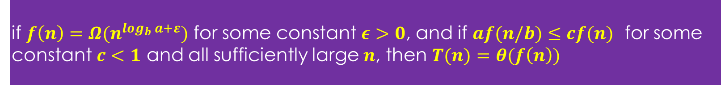
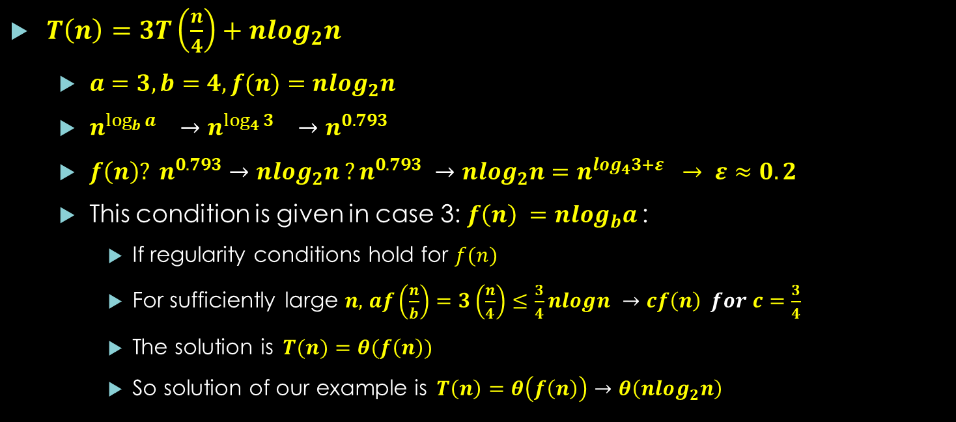
Example 3
if $f\left(n\right)=Ω(n^{\log_{b}{a+ε}})$ for some constant $ε>0$, and if $af(n/b)≤cf(n)$ for some constant $c<1$ and all sufficiently large $n$, then $T(n)=θ(f\left(n\right))$
$T\left(n\right)=3T\left(\frac{n}{4}\right)+nlog_{2}n$
$a=3, b=4, f(n)=nlog_{2}n$
$n^{\log_{b}{a}} →n^{\log_{4}{3}} →n^{0.793}$
$f\left(n\right)? n^{0.793}→nlog_{2}n ?n^{0.793} →nlog_{2}n=n^{log_{4}3+ε} → ε≈0.2$
This condition is given in case 3: $f\left(n\right) =nlog_{b}a$:
If regularity conditions hold for $f(n)$
For sufficiently large $n,$ $af\left(\frac{n}{b}\right)=3\left(\frac{n}{4}\right)≤\frac{3}{4}nlogn →cf\left(n\right) for c=\frac{3}{4}$
The solution is$T(n)=θ(f\left(n\right))$
So solution of our example is$T\left(n\right)=θ\left(f\left(n\right)\right)→θ\left(nlog_{2}n\right)$

Slide 9

Example 5
if $f\left(n\right)=O(n^{\log_{b}{a}})$ then $T\left(n\right)=θ\left(n^{\log_{b}{a}}\log_{2}{n}\right)$
$T\left(n\right)=2T\left(\frac{n}{2}\right)+θ(n)$
$a=2, b=2, f(n)=θ(n)$
$n^{\log_{b}{a}} →n^{\log_{2}{2}} →n$
$f\left(n\right)?n→n ?n →n=n$
This condition is given in case 2
So the solution is $T\left(n\right)=θ\left(n^{\log_{b}{a}}\log_{2}{n}\right)→θ\left(n^{1}\log_{2}{n}\right)→$ $θ\left(n\log_{2}{n}\right)$

Slide 10

Example 4
$T\left(n\right)=2T\left(\frac{n}{2}\right)+nlog_{2}n$
$a=2, b=2, f(n)=nlog_{2}n$
$n^{\log_{b}{a}} →n^{\log_{2}{2}} →n^{1}$
$f\left(n\right)? n^{1}→nlog_{2}n ?n^{1}$
First case is not applicable as $f(n)$can not be expressed as $f\left(n\right)=O\left(n^{\log_{b}{a−ε}}\right)$
Second case can not be applied as $f(n)$can not be expressed as $f\left(n\right)=O\left(n^{\log_{b}{a}}\right)$
3rd case can not be applied as $f(n)$can not be expressed as $f\left(n\right)=Ω(n^{\log_{b}{a+ε}})$
Somehow you can think of case 3 as $f\left(n\right)≥Ω\left(n^{\log_{b}{a+ε}}\right)→$ $f\left(n\right)≥Ω\left(n^{1}\right) for ε=0$
Although our function is larger in 3rd case however the problem is that it is not polynomially larger.
$\frac{f\left(n\right)}{nlog_{b}a}→\frac{nlogn}{n}→logn is aympotatically less than ε for any positive value of ε$
The recurrence falls in the gap between case 2 and 3

Slide 11
Thanks for watching
Dr. Sajid Iqbal
Assistant Professor
Department of Computer Science
Bahauddin Zakariya University, Multan
Allah Hafiz

